Slide 1

Strategic Lending Insights: A Comprehensive Analysis of Bank Loan Data

Slide 2

Contents
Introduction
Project Overview
Tools & Technologies
Meet the Borrowers
Key Takeaways and Conclusion

Slide 3
INTRODUCTION
OBJECTIVE:
This project aims to analyze bank loan data to identify trends, borrower behaviors, and risk patterns. The goal is to improve loan approval accuracy, minimize defaults, and build a more human-centered lending strategy.
IMPORTANCE:
This analysis helps financial institutions:
Monitor and improve their loan portfolios.
Identify trends and patterns in loan applications, disbursements, and repayments.
Assess the financial health of borrowers and make data-driven decisions.

Slide 4
OVERVIEW
Scope of Analysis:
Loan Applications: Tracking the total number of loan applications received over time.
Funded Amounts: Assessing the total amount of funds disbursed as loans.
Repayment Patterns: Evaluating the total amount received from borrowers and analyzing repayment behaviors.
Key Performance Indicators (KPIs): Monitoring critical metrics such as average interest rate and average debt-to-income ratio (DTI).
Loan Status Analysis: Differentiating between good loans (fully paid and current) and bad loans (charged off) to understand their respective metrics.

Slide 5
Data Source
The dataset used for this analysis is a subset of Lending Club data, obtained from Hugging Face. This dataset provides comprehensive information on loan applications, funded amounts, borrower details, and repayment statuses.
Source: Lending Club Dataset on Hugging Face
Tools and Technologies
Data Storage and Management: MySQL for data preprocessing and storage.
Data Analysis and Visualization: Power BI for creating interactive dashboards and visualizations.
Programming and Scripting: SQL for data querying and preprocessing.

Slide 6
Key Questions Answered
How many loan applications were received and funded during the specified period?
What are the trends and patterns in loan applications and disbursements over time?
How do different borrower characteristics affect loan performance?
What is the overall health of the loan portfolio in terms of average interest rates and DTI ratios?

Slide 7
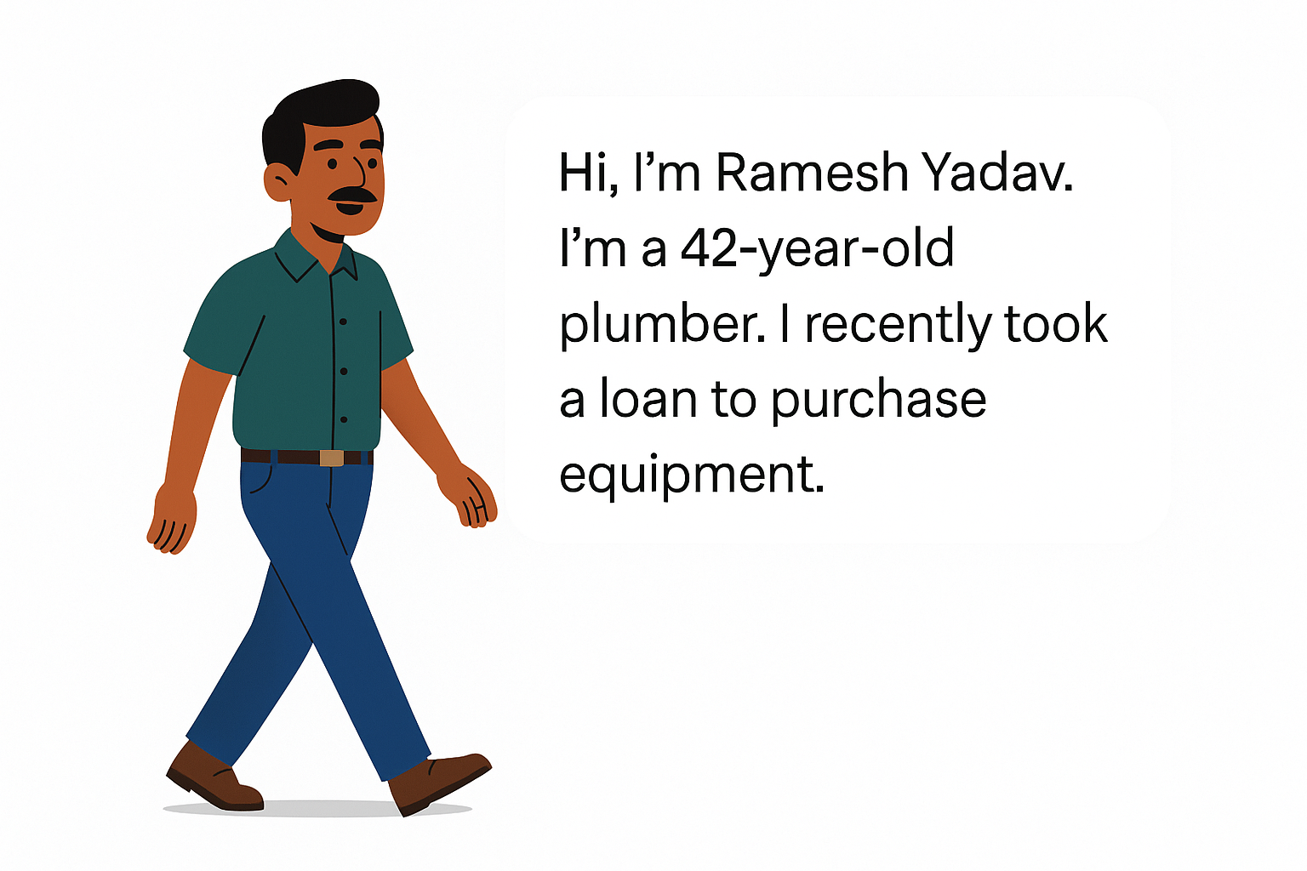

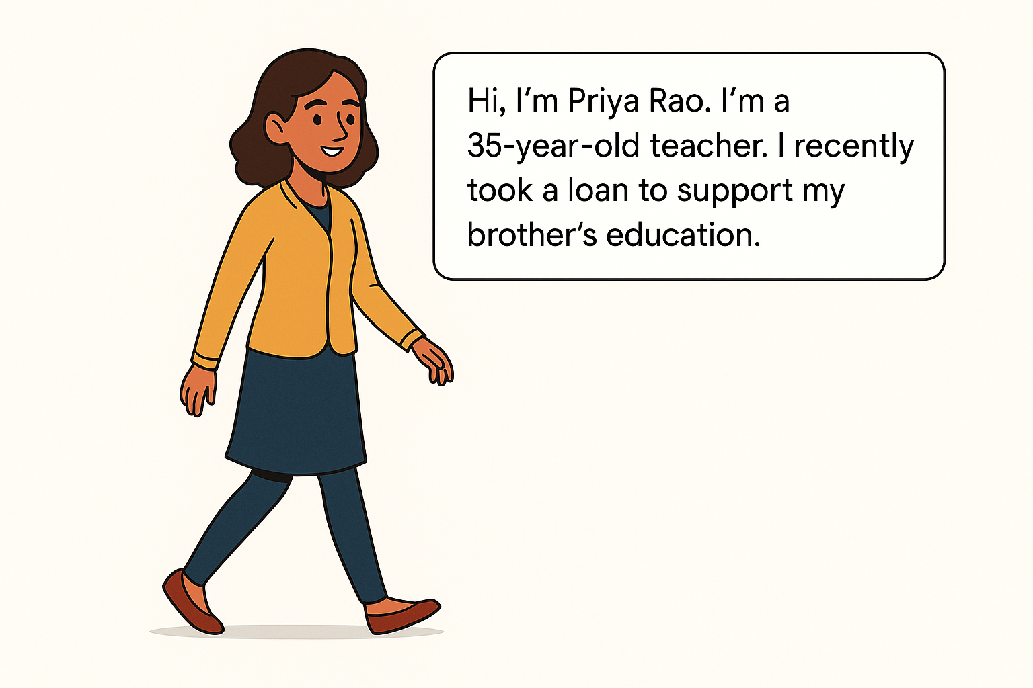
Meet The Borrowers

Slide 8
Key Takeaways
Loan applications up to 38.6K (+6.9%)
Funded amount: $435.8M (+13%)
Collections: $473.1M (+15.8%)
Interest rate dropped to 12.0%
Average DTI improved to 13.3%
86% good loans, 14% bad loans
Bad loans recovered only 57%
Applications rising month by month
Most loans from Eastern/Southeastern US
Borrowers: long-tenure & mostly renters
Top purpose: Debt consolidation

Slide 9
Action Items to Create Business Impact
Forecast loan surges using predictive models for better resource planning.
Apply risk-based pricing to offer better rates to low-risk borrowers.
Use ML models to detect early default risks and act preemptively.
Analyze regional markets to target underserved areas.
Create tailored loan products based on feedback and trends.

Slide 10
CONCLUSION
Data-driven insights enable a deep understanding of loan performance and borrower behavior . Findings support strategic, risk-aware decision-making to improve efficiency and lending outcomes . Predictive analytics and continuous monitoring are key to managing risk and driving growth . To stay competitive, the bank must invest in advanced analytics and adapt to evolving market needs.

Slide 11
Team Members
Vikram Maram
Abhinav Reddy
Gayathri Belide
Srinija Kore
Tulika Polarouthu

Slide 12
Quote of the Day
Behind every data point is a person. Behind every loan, a life story.

Slide 13
THANK YOU

